Slide 1

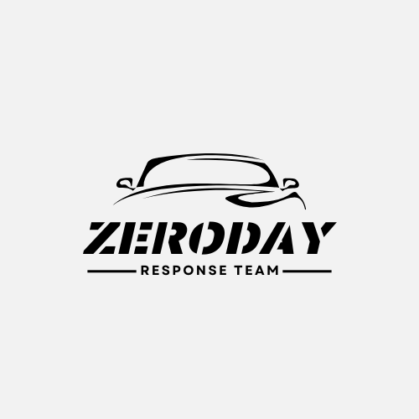
Team Overview ZeroDay Response Team
Henry Ng, s5423376, (Project Manager & Team Leader)
Minhaj Ahmed, s5419774, (Security Architect)
Ansaf Althaf, s5405482, (Security Engineer)
Sherina Lu, s2717884, (Security Analyst)

Slide 2

Presentation Overview
ZeroDay Response Tackles Phishing with ServiceNow

Slide 3
Table of Contents
Project Presentation
Project Introduction
Motivation
Objectives & Outcomes
Critical Issues
Innovative Solution Proposals
Tools Used
Methodology
V-Model
Risk & Sustainment Plan
Project Impact
Prototype Demo in ServiceNow
Q&A

Slide 4
Project Introduction & Motivation
Purpose – ⬇️ successful email phishing attacks by at least 50%
Motivation – ⬆️ staff morale and confidence in detecting phishing emails
How to do that? Technical solutions (ServiceNow), Microsoft Authenticator, incident response management, role-based access controls (RBAC), KnowBe4
Non-technical solutions – 24/7 support team answering Q&A tailored for each staff member's knowledge and understanding
We understand the difficulties you're encountering, and we're here to support you with solutions that make a meaningful difference 🤝🙂🔧

Slide 5
Objectives & Outcomes
Strengthened Cybersecurity Posture: Strengthen the organisation’s cybersecurity by reducing email phishing vulnerability by 50% by end-2025 and 90% by end-2026, alongside a 30% reduction in related costs.
Incident Reporting: Maintain a detailed record of phishing incidents in ServiceNow, with a rolling 30-day dashboard for real-time monitoring.
Streamlined Incident Management: Implement a customised incident management workflow in ServiceNow to ensure response times under 30 minutes and prompt service restoration.
Upgraded Security Infrastructure: Upgrade security infrastructure through integration of MFA and RBAC within existing systems, targeting 100% resolution of integration issues by project completion.
On-going Training Program: Establish a quarterly staff training program with phishing simulations and refresher courses to mitigate cyber threats.

Slide 6
What is email phishing?📧🎣
Email phishing: A cyberattack in which individuals are deceived into disclosing login credentials or sensitive information via fraudulent emails and malicious links, often leading to password breaches and data theft.

Slide 7
Critical issues
Documentation and Awareness 📘
Phishing email attacks 🕵️
Password Compromises 🔓
Staffs receive fake emails impersonating company executives and HR leading to financial loss through fraudulent fund transfers
Weak employee passwords have increased the success rate of phishing attacks, exposing internal systems to unauthorised access and data breaches
Incidents have not been documented or used to update training materials, reducing the effectiveness of employee training

Slide 8
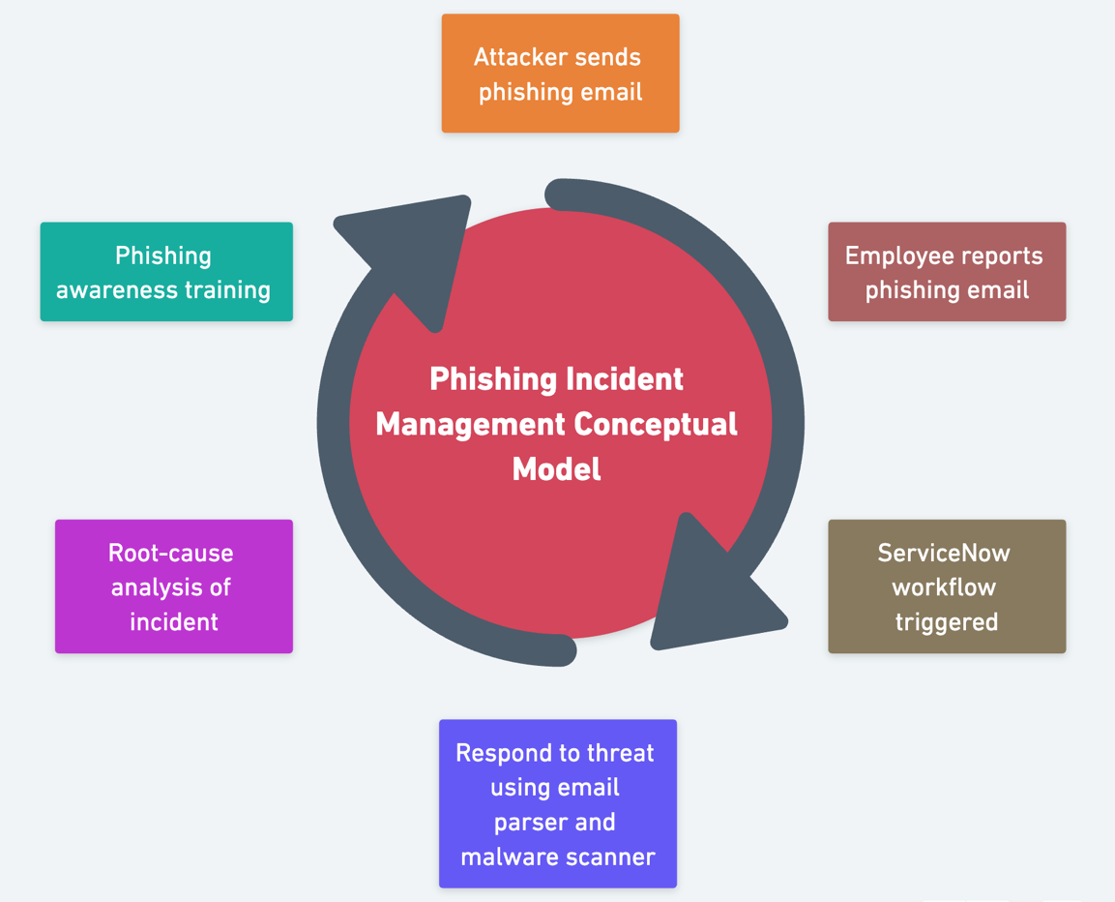
Innovative Solution Proposals #1

Slide 9
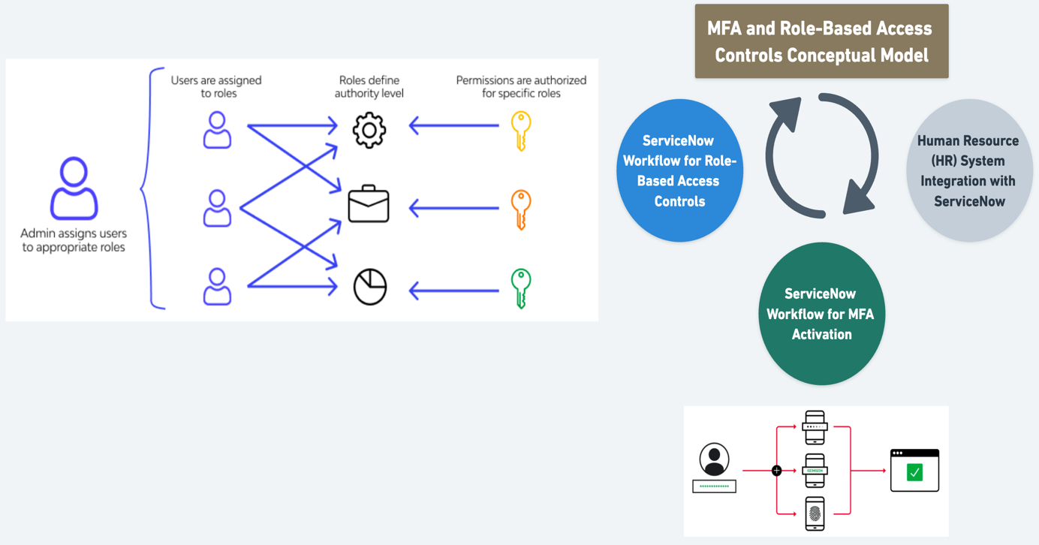
Innovative Solution Proposals #2

Slide 10
Tools Used 🔧
Software
Description
A cloud-based ITSM platform that automates incident response and workflows. It will track phishing and MFA-related issues by integrating with the company’s CRM, ERP, and IoT systems.
ServiceNow
An MFA application, in sync with Azure Active Directory (AD) to access accounts securely. It improves login security by requiring users to validate their identity through push notifications, OTP codes, or biometric verification.
Microsoft Authenticator
Zapier
An automation tool that connects to ServiceNow to parse emails and send structured data, enabling faster phishing incident response.
An open-source threat intelligence tool that scans emails for malicious files, URLs, and IPs using antivirus engines and behaviour analysis, providing malware detection and threat classification
VirusTotal

Slide 11
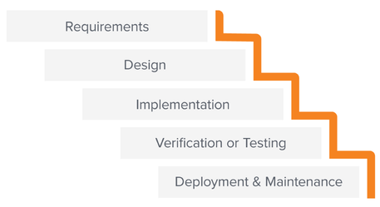
Methodology
Waterfall is a sequential project methodology where each phase planning, development, testing, and deployment follows a fixed order with little overlap.
Why did we choose it?
Fixed Requirements 📋: The project scope, including MFA and phishing workflows, was well-defined from the start.
Clear Phase Structure 📊: Tasks were designed to follow a strict order. Design first, implementation next, then testing.
Milestone-Based Progress 🎯: Communication and reviews with stakeholders were scheduled only at key milestones, aligning well with the Waterfall model.
End-to-End Testing 🧪: Testing and issue resolution were planned as a separate phase, which fits Waterfall’s structure.

Slide 12
V-Model (Verification and Validation)
✅ Early bug detection
⚙️ Confident integrations with external IT systems
📈 Scalable, testable, and reliable automation
One of our 🔑 objectives:
Aim for integration bugs 100% FREE by the end of project.
What will we do? Schedule 2️⃣ rounds of system integration testing
📨 Phishing Reported → Test: Incident is created
🔍 Domain Check → Test: Flag as malicious if blacklisted
🔗 IT System Integration → Test: AD account is disabled
📬 Notify Users → Test: Email sent with resolution update

Slide 13
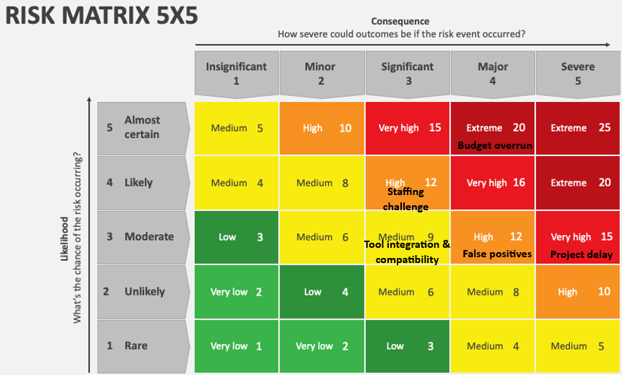
Risk & Sustainment Plan
Risk Title | Description | Priority | Actions / Timelines
Budget Overrun ⚠️💵 | Project exceeds allocated budget | ❗❗❗ | 1️⃣ Create a 10% contingency buffer. 2️⃣ Track actual vs. budget monthly.
Project Delays 🕒⏳ | Delay in key phases | ❗❗❗ | 1️⃣ Set milestone dates. 2️⃣ Hold fortnightly progress meeting. 3️⃣ Use project dashboard for real-time tracking. 4️⃣ Escalate unresolved blockers within 48 hours.
Risk | Likelihood | Consequence | Risk Level
Budget Overrun | 5 | 4 | 20🚨
Staffing Challenges | 4 | 3 | 12
Tool Integration Compatibility | 3 | 3 | 9
False Positives | 3 | 4 | 12
Project Delays | 5 | 3 | 15🚨
Ongoing Monitoring & Maintenance:
🔄 Automation – 24/7 Monitoring & Incident Management on ServiceNow
🧠Targeted Training – Quarterly stimulation test & awareness refresher training
📊 Continuous Evaluation – Performance Dashboards & Scheduled Maintenance

Slide 14
Project Impact
Costs 💰💰💰
Benefits 🌟🌟🌟
Average cost of a phishing attack exceeds USD$4 million.
The total budget is projected at approximately USD$2.3 million per year.
Organisations could save up to USD$1.9 million if they have implemented IR plannings and employee training.
💻A structured and automated phishing detection and response system is implemented and centrally integrated with ServiceNow.
🚀24/7 team has set up to provide on-going IT support and training.
💪Enhance network security with MFA & RBAC.
🎯 Achieve the 5 project GOALS.
 | 2025 | 2026
Planning cost
 | $169,500 | $38,500
Staff cost
 | $1,157,500 | $1,205,375
Software cost
 | $888,338 | $883,588
Hardware cost
 | $66,600 | $2,000
Total cost | $2,281,938 | $2,129,463

Slide 15
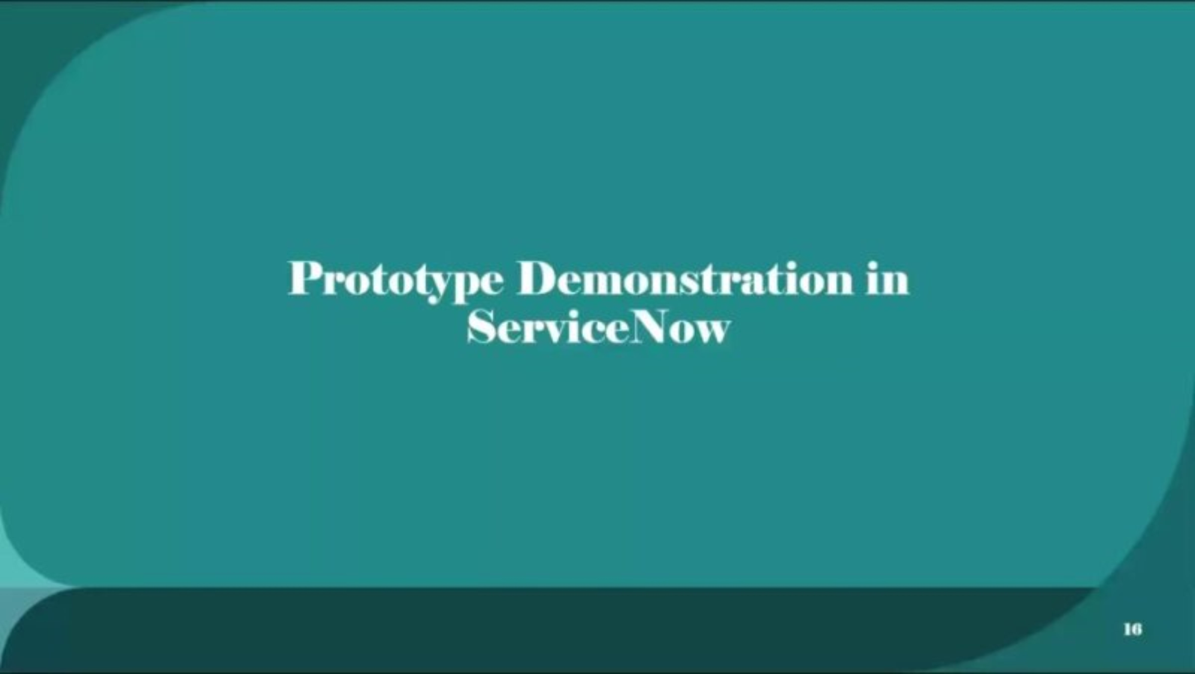
Prototype Demonstration in ServiceNow

Slide 16

Q&A

Slide 17
Thank you
ZeroDay Response Team
Henry Ng, s5423376, (Project Manager and Team Leader)
Minhaj Ahmed, s5419774, (Security Architect)
Ansaf Althaf, s5405482, (Security Engineer)
Sherina Lu, s2717884, (Security Analyst)

